Slide 1
Learning Big Data
Aditya Konda
Big Data Engineer

Slide 2
Content
Spark
Introduction
Computing engine
Features
RDD
Transformations and actions
Linage and Cache
Architecture
Components

Slide 3

Spark
An open source cluster computing framework
Designed for handling massive amount of data
Very efficient than MapReduce computing engine
Offers the ability to access data in a variety of sources such as HDFS, cassandra, and amazon S3

Slide 4
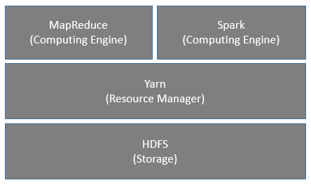
Spark – Computing Engine

Slide 5
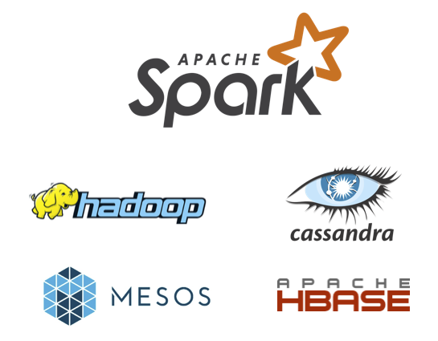
Spark – Features
Speed: Run programs up to 100x faster than Hadoop MapReduce in memory, or 10x faster on disk.
Easy to use: Write applications quickly in Java, Scala, Python, R
Generality: Combine SQL, streaming, and complex analytics.
Runs Everywhere: Spark runs on Hadoop, Mesos, standalone, or in the cloud. It can access diverse data sources including HDFS, Cassandra, HBase, and S3.

Slide 6
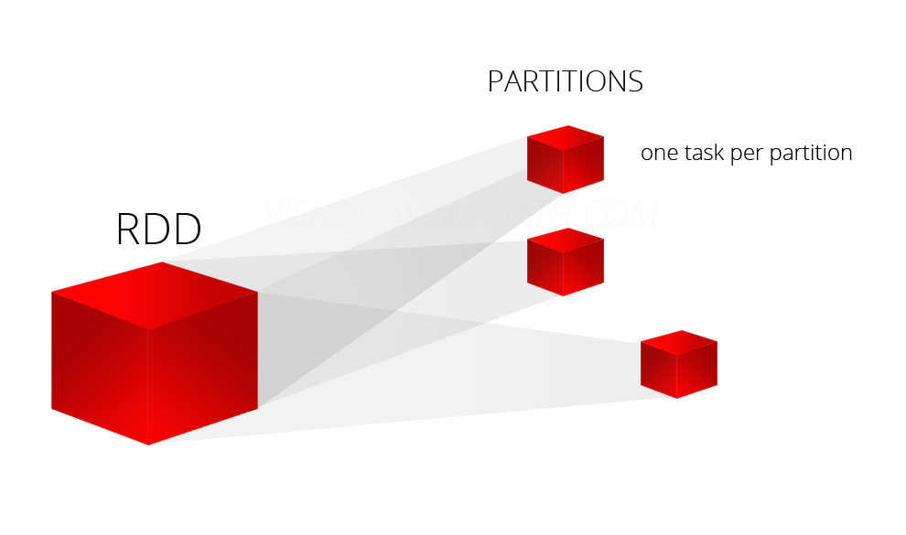
Resilient Distributed Datasets (RDD)
RDD Are Automatically Distributed Across The Network By Means Of Partitions.
Divided Into Smaller Chunks Called Partitions
Lazily evaluates an RDD
Spark Automatically Decides The Number Of Partitions That An RDD Has To Be Divided Into
Partitions Of An RDD Is Distributed Across All The Nodes In The Network

Slide 7
Resilient Distributed Datasets (RDD)
Operation performed on RDD
Actions
Transformation
Transformation: applies some function on a rdd and creates a new rdd
Action: performs actions on rdd, example: rdd.Count()
val rdd = sc.textFile(“c:\sample\Read.md",3)
val lines = sc.parallelize(List(“"ann", "f", "90", "world", "23456"”))

Slide 8
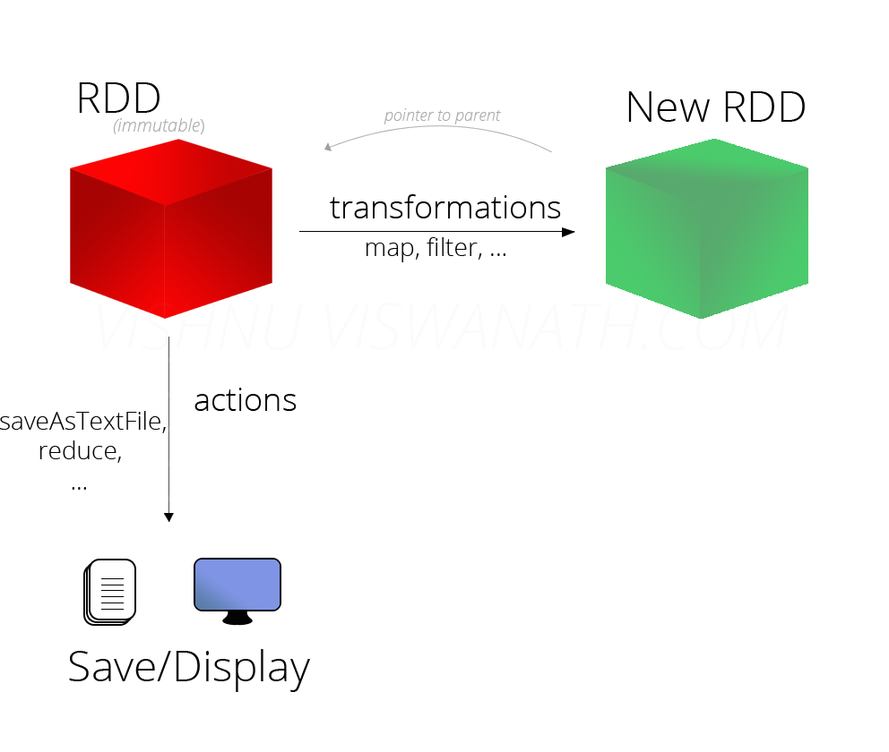
Transformations and Actions

Slide 9
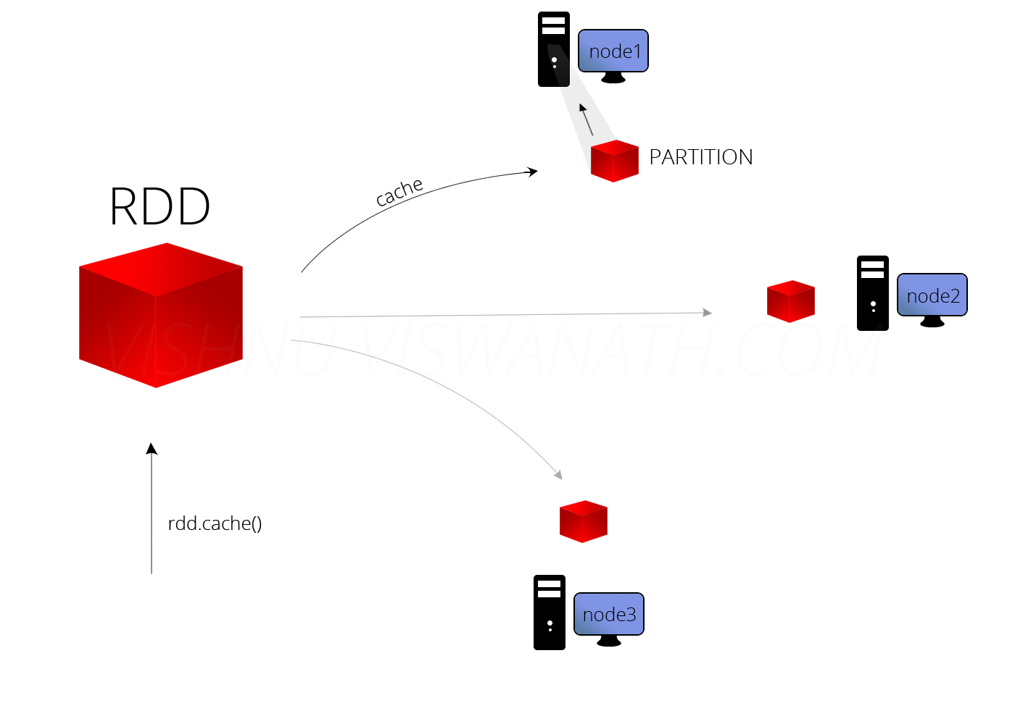
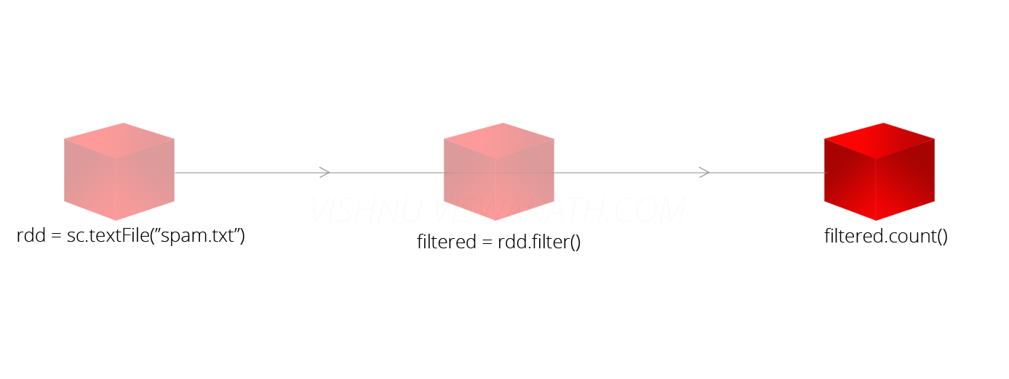
Linage and Cache
Linage: keeps track of what all transformations has to be applied on that RDD
Cache an RDD in memory

Slide 10
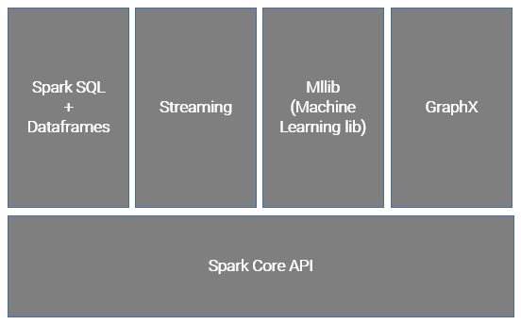
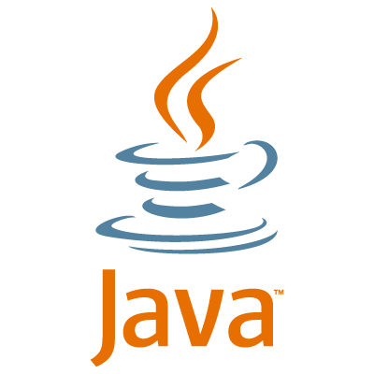



Spark – Architecture

Slide 11
Spark – Components
Dataframes: Spark Dataframes is a distributed collection of data where it is organized into rows and columns
Mllib: MLlib (i.e. Machine Learning Library) consists of common learning algorithms. Used to understand patterns of customers.
Streaming: an extension of core Spark API that enables scalable, high-throughput, fault-tolerant stream processing of live data streams
GraphX: Simple graph API to find visualization/ connection in a data.

Slide 12
Resources
Apache Spark features
Spark RDD
Overview of Spark Architecture
Spark tutorial by Databricks

Slide 13


